Slide 1
basic Linux commands part 2
Nguyen Quang Khai
23/05/2024

Slide 2
Contents
I. Working with text file.
1. Search and filter.
2. Input/output redirection.
II. Some other commands
3. Download file.
4. File permission.
5. Compress and decompress.

Slide 3
1. Search and filter

Slide 4
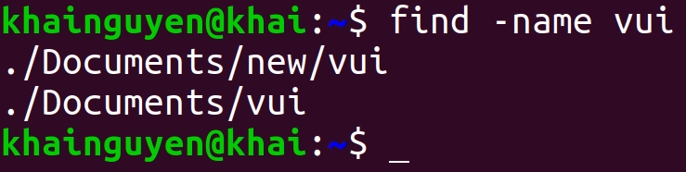
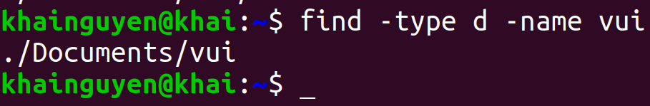
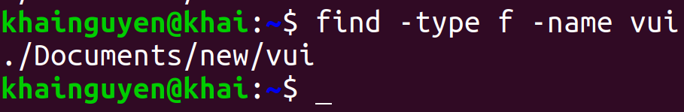
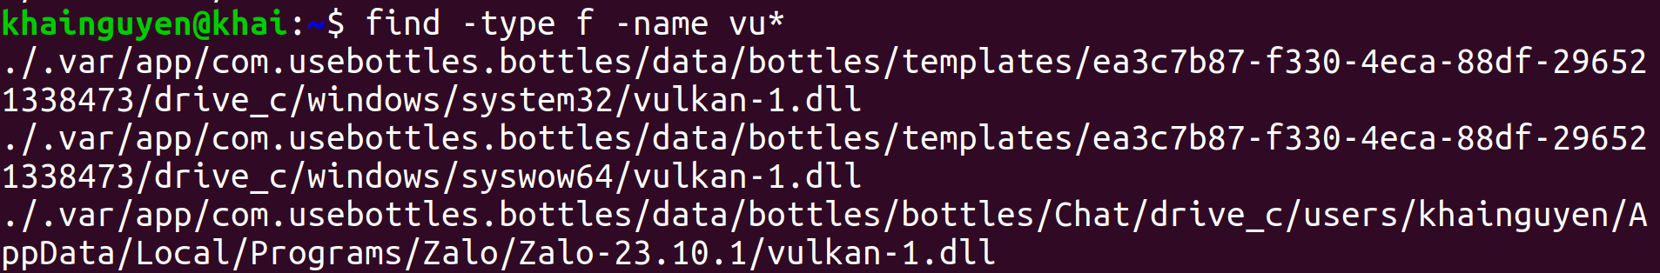
Search and filter
find command: search for files or directories in a directory
Search for files and directories named "vui", with -name option:
Search for directories named "vui", with -type option, d means directory:
Search for files named "vui", with -type option, f means file:
don't remember the file name clearly, but there is "vu" at the beginning of the name:
* means zero or any characters

Slide 5
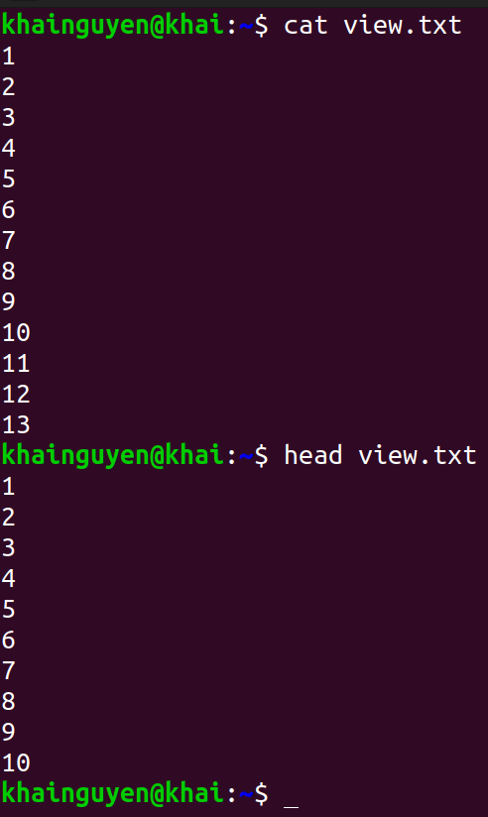
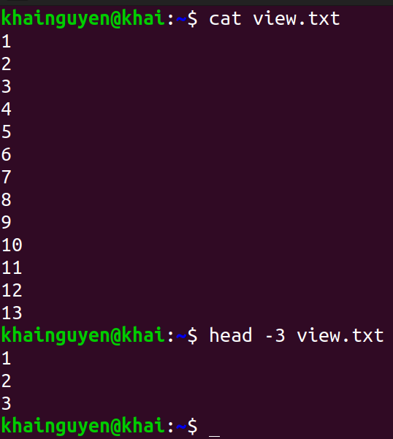
Search and filter
head command: prints the first few lines in the file
Default: prints the first 10 lines in the file:
print the first #number lines instead of the first 10

Slide 6
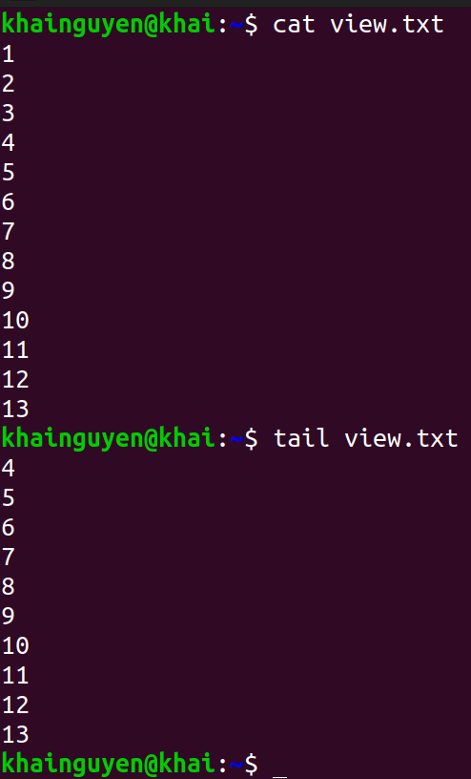
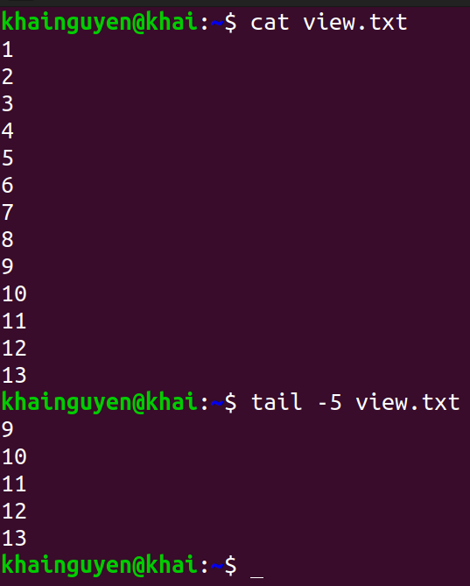
Search and filter
tail command: prints the last few lines in the file
Default: prints the last 10 lines in the file:
print the last #number lines instead of the last 10

Slide 7
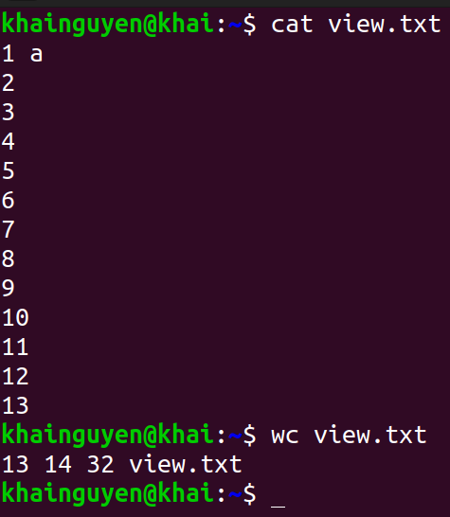



Search and filter
wc command: print newline, word, and byte counts for each given file
Default:
select which counts are printed:
13 lines, 14 words, 32 bytes
wc --help: A word is a non-zero-length sequence of characters delimited by white space.

Slide 8
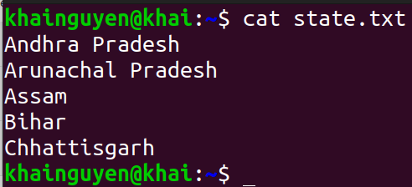
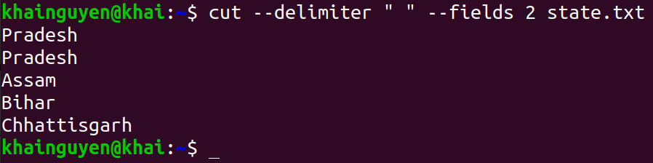
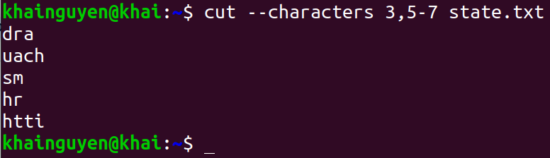
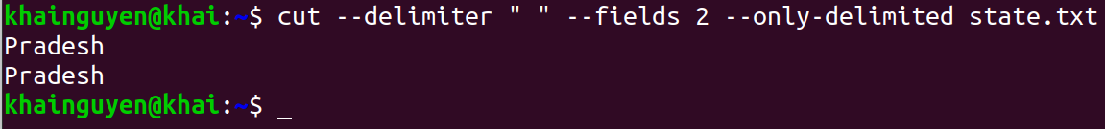
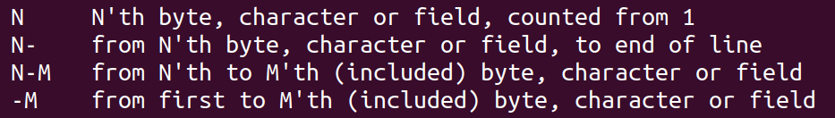
Search and filter
cut command: Print selected parts of lines from each FILE
Specify fields separated by a space,
printing the 2nd field:
Print the 3rd character, 5th to 7th characters of the file:
use --only-delimited option: do not print lines not containing delimiters
cut --help:

Slide 9
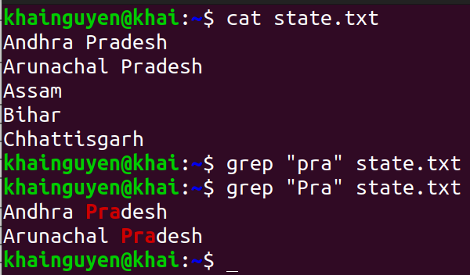
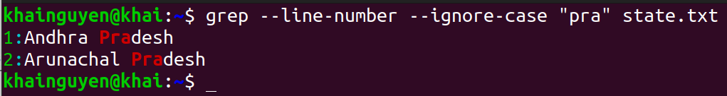
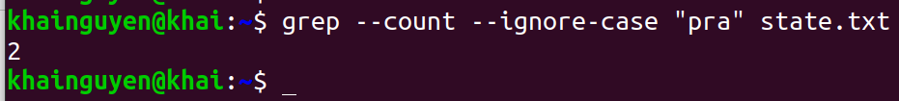
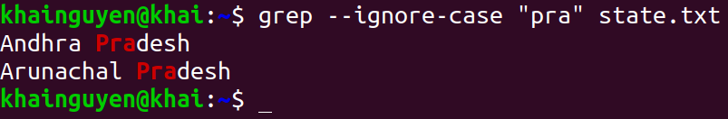
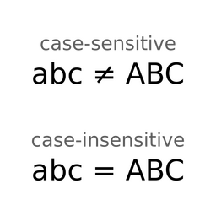
Search and filter
grep command: print lines that match patterns
Default: case-sensitive
--line-number option: Display the matched lines and their line numbers.
--count option: print a count of matching lines
--ignore-case option: case-insensitive
--invert-match option: print non-matching lines

Slide 10
2. input/output redirection

Slide 11
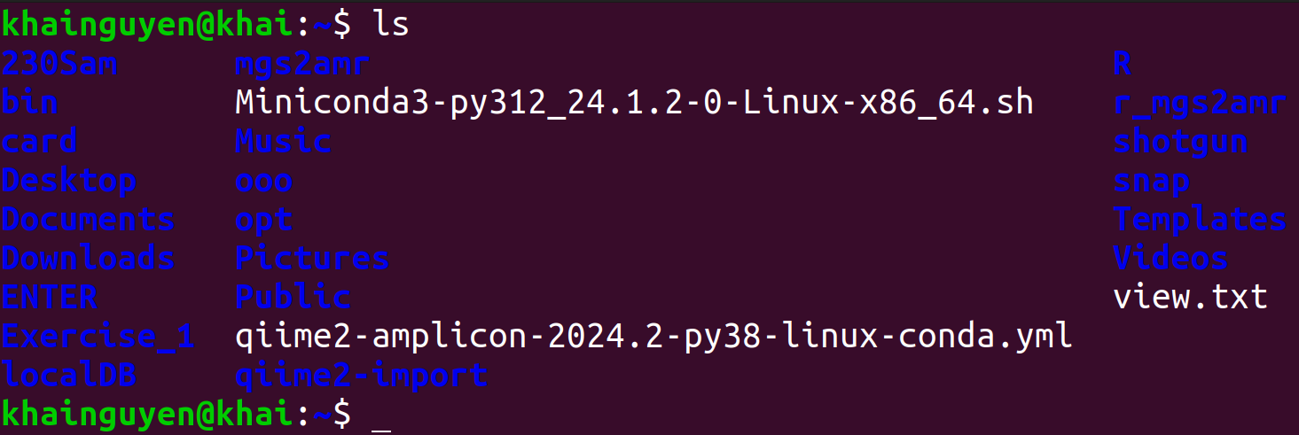
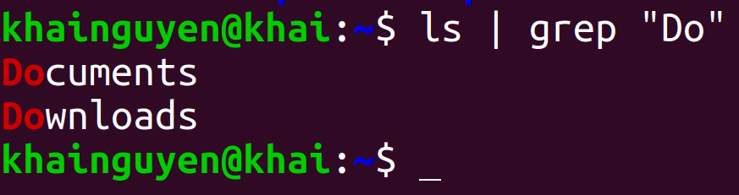
input/output redirection
Piping
Pipe is formed using the vertical dash |
A | B | output of command A will be input of B command.
A | B | C output of command A will be input of B command, output of command B will be input of C command.
The pipe is used to combine two or more commands.
Example:
ls | grep “Do"
ls's output
grep's input
grep's output

Slide 12
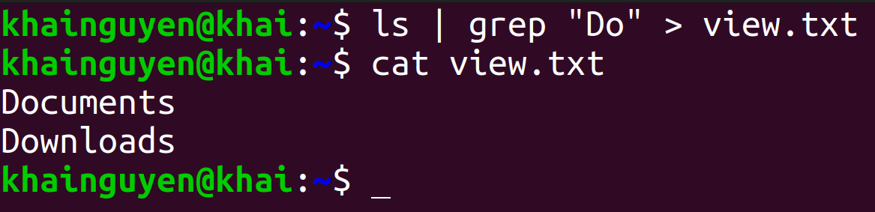
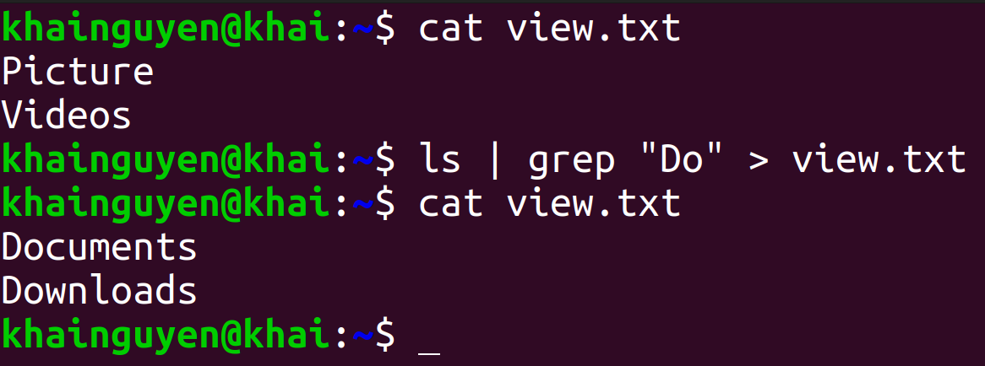
input/output redirection
Output redirection: The ">" character
To redirect output to a file
If the view.txt file already exists, its content will be overwritten

Slide 13
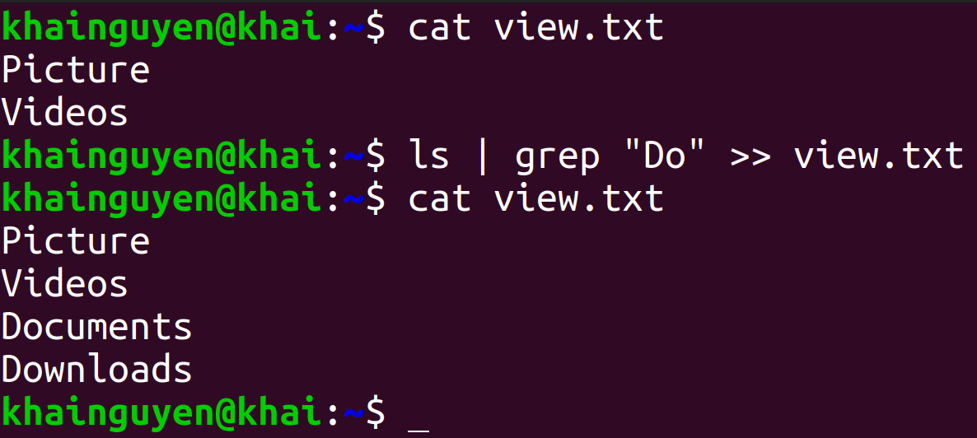
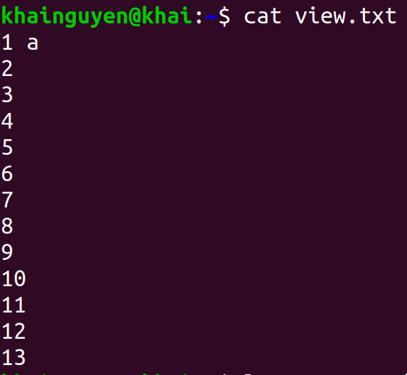

input/output redirection
If you do not want the content to be overwritten, use the ">>" character
Input redirection: The "<" character

Slide 14
3. Download file

Slide 15
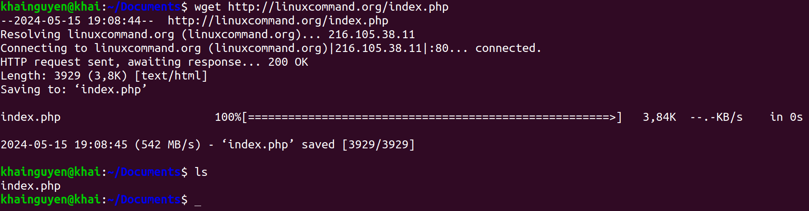
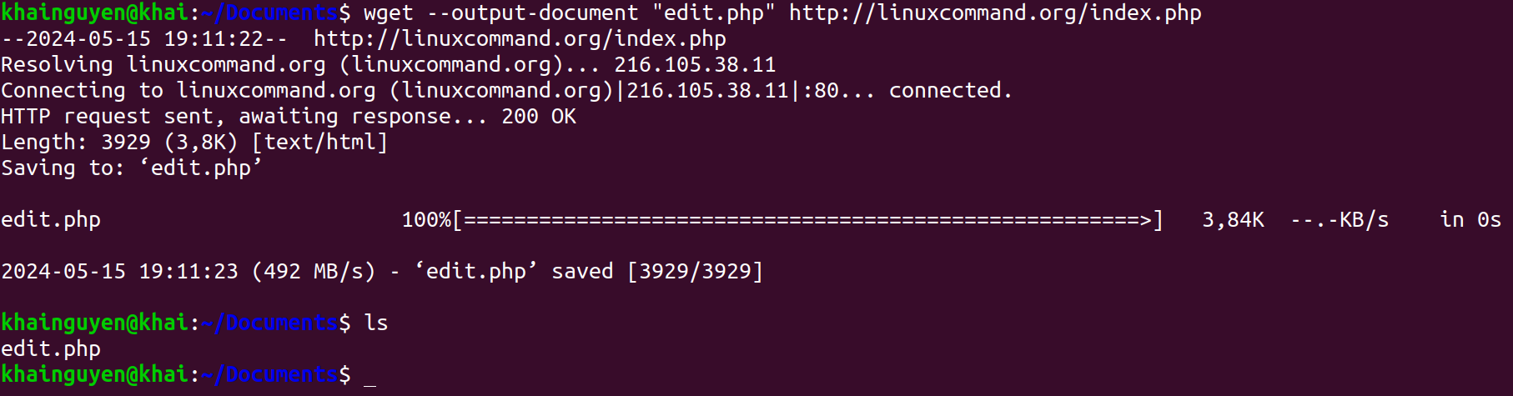
Download file
wget command: Downloader
Default: Download file from a URL
--output-document option: download file from URL, with a different name

Slide 16
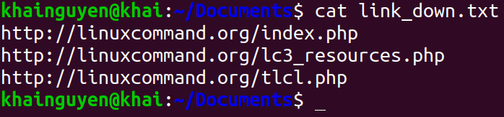
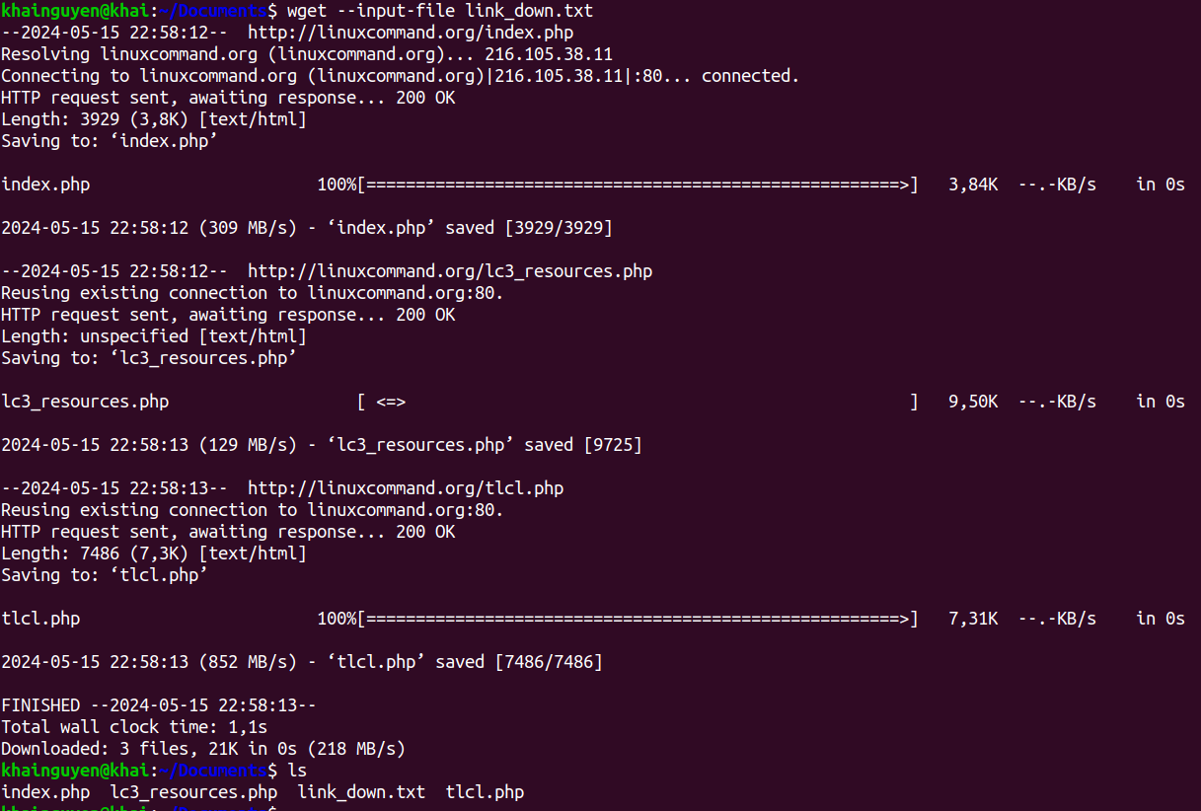
Download file
--input-file option: download from multiple URL
1. Create a text file containing URLs, each line includes a URL, use: nano.
2. wget --input-file link_down.txt

Slide 17
4. File permission

Slide 18
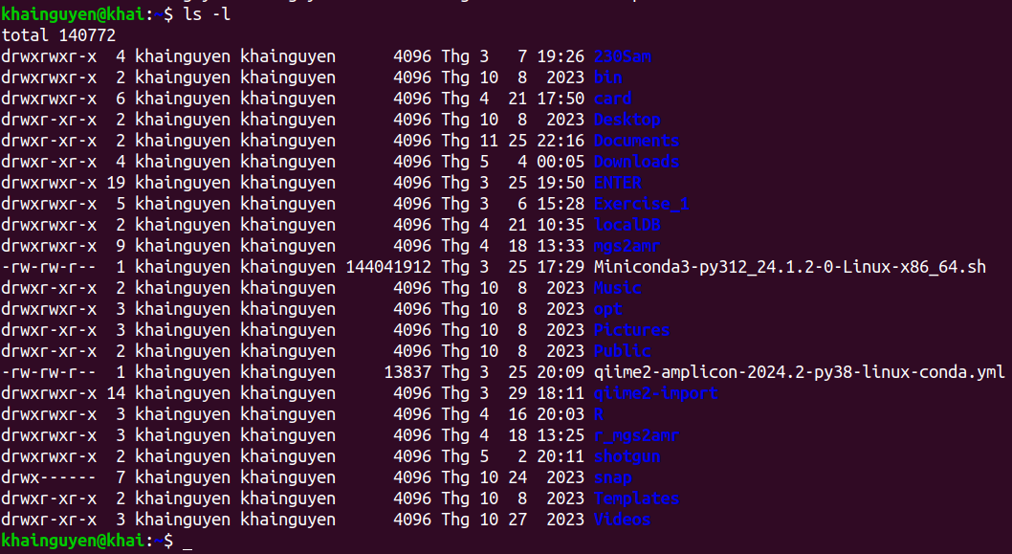
When run: ls -l
user (or owner)
permission
other
permission
Owner of file
(user_name)
user group
group
permission
snap directory
- User permission: read (yes), write (yes), execute (yes).
- Group permission: read (no), write (no), execute (no).
- Other permission: read (no), write (no, execute(no).
Meaning of r, w, x, -:
r = readable
w = writeable
x = executable
- = denied
Templates directory
- User permission: read (yes), write (yes), execute (yes).
- Group permission: read (yes), write (no), execute (yes).
- Other permission: read (yes), write (no), execute (yes).

Slide 19
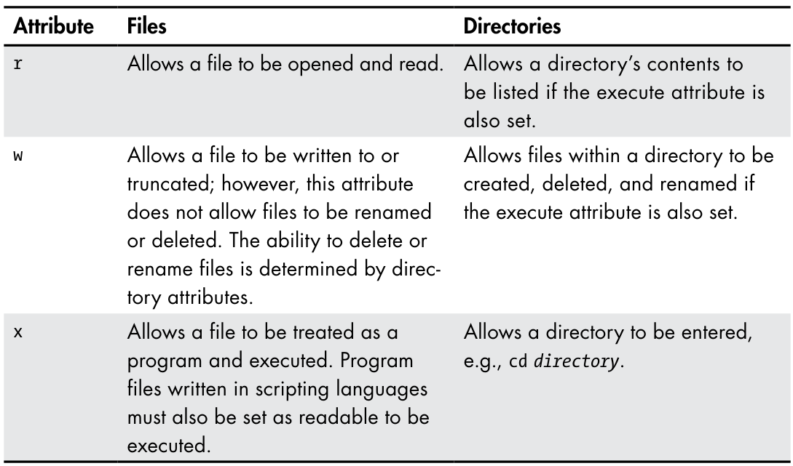
Permission Attributes
https://shorturl.at/prOPY

Slide 20

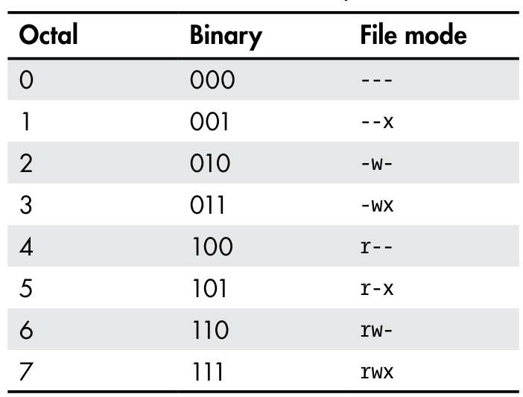
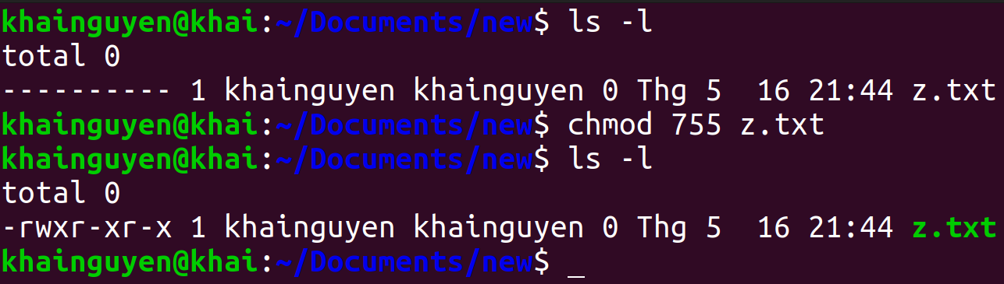
chmod: Change File Mode
To change the mode (permissions) of a file or directory, use the chmod command.
chmod supports two distinct ways of specifying mode changes:
1. Octal number representation
rwx
(user)
r-x
(group)
r-x
(other)
File Modes in Binary and Octal
https://shorturl.at/prOPY

Slide 21
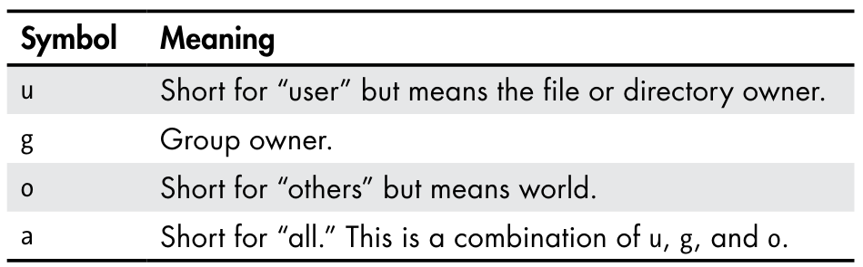
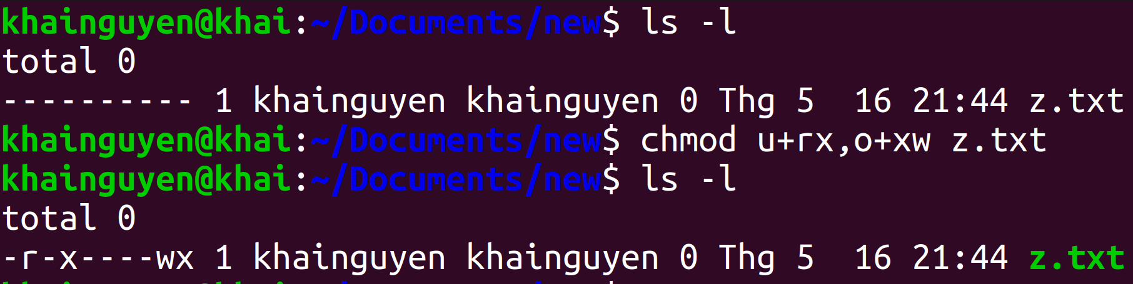
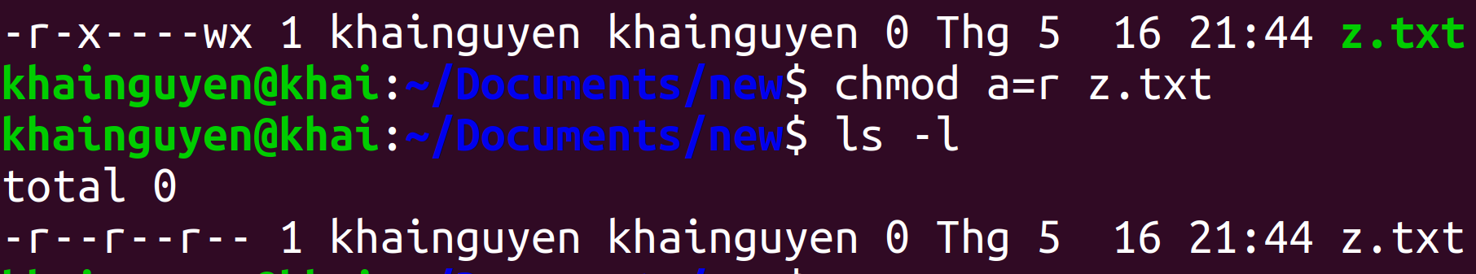
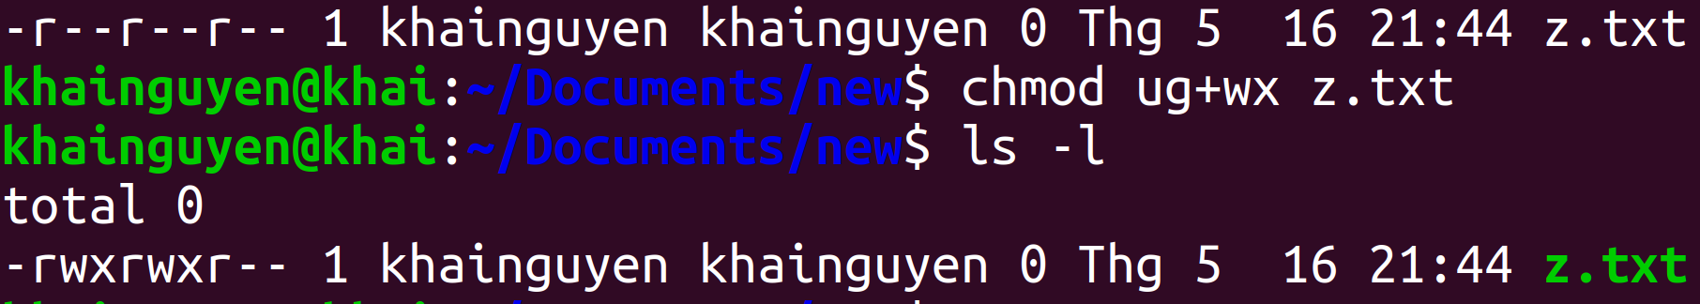
chmod: Change File Mode
2. Symbolic representation
chmod Symbolic Notation
If no character is specified, “all” will be assumed.
+ a permission is to be added.
- a permission is to be taken away.
= only the specified permissions are to be applied and that all others are to be removed.
Permission:
r readable
w writeable
x executable
https://shorturl.at/prOPY

Slide 22
5. Compress and decompress

Slide 23
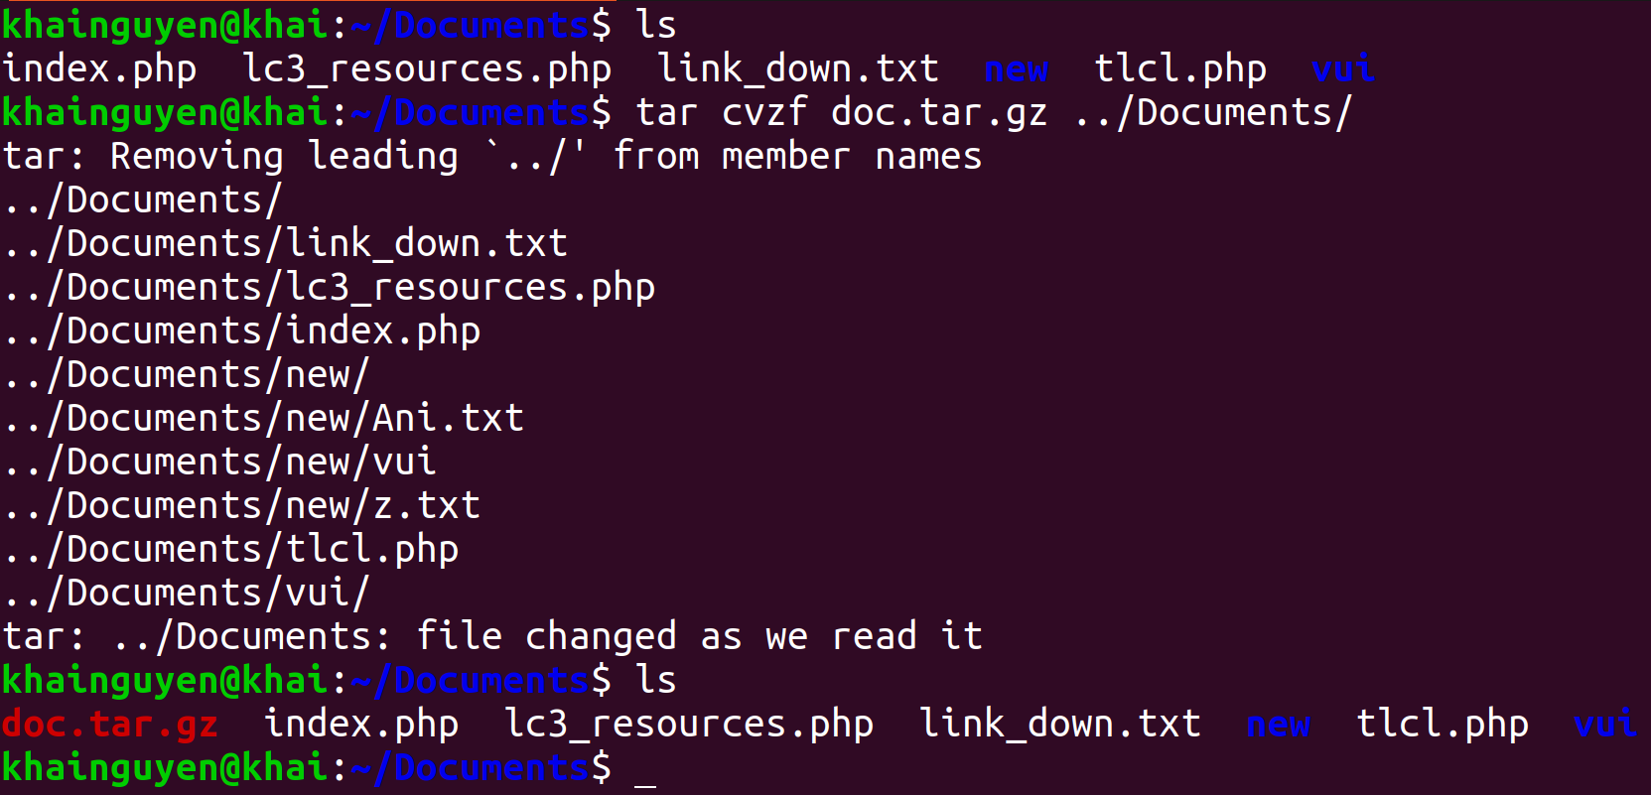
Compress and decompress
tar command: compress and decompress
Compress all files and directories in the “Documents" directory to a compressed file named “doc.tar.gz"
-c --create: create a new archive file
-z, --gzip: Using gzip to compress
-f or --file: compressed file name
-v or --verbose: Verbosely list files processed
The four options "-c -v -z -f" can be written as "cvzf"

Slide 24
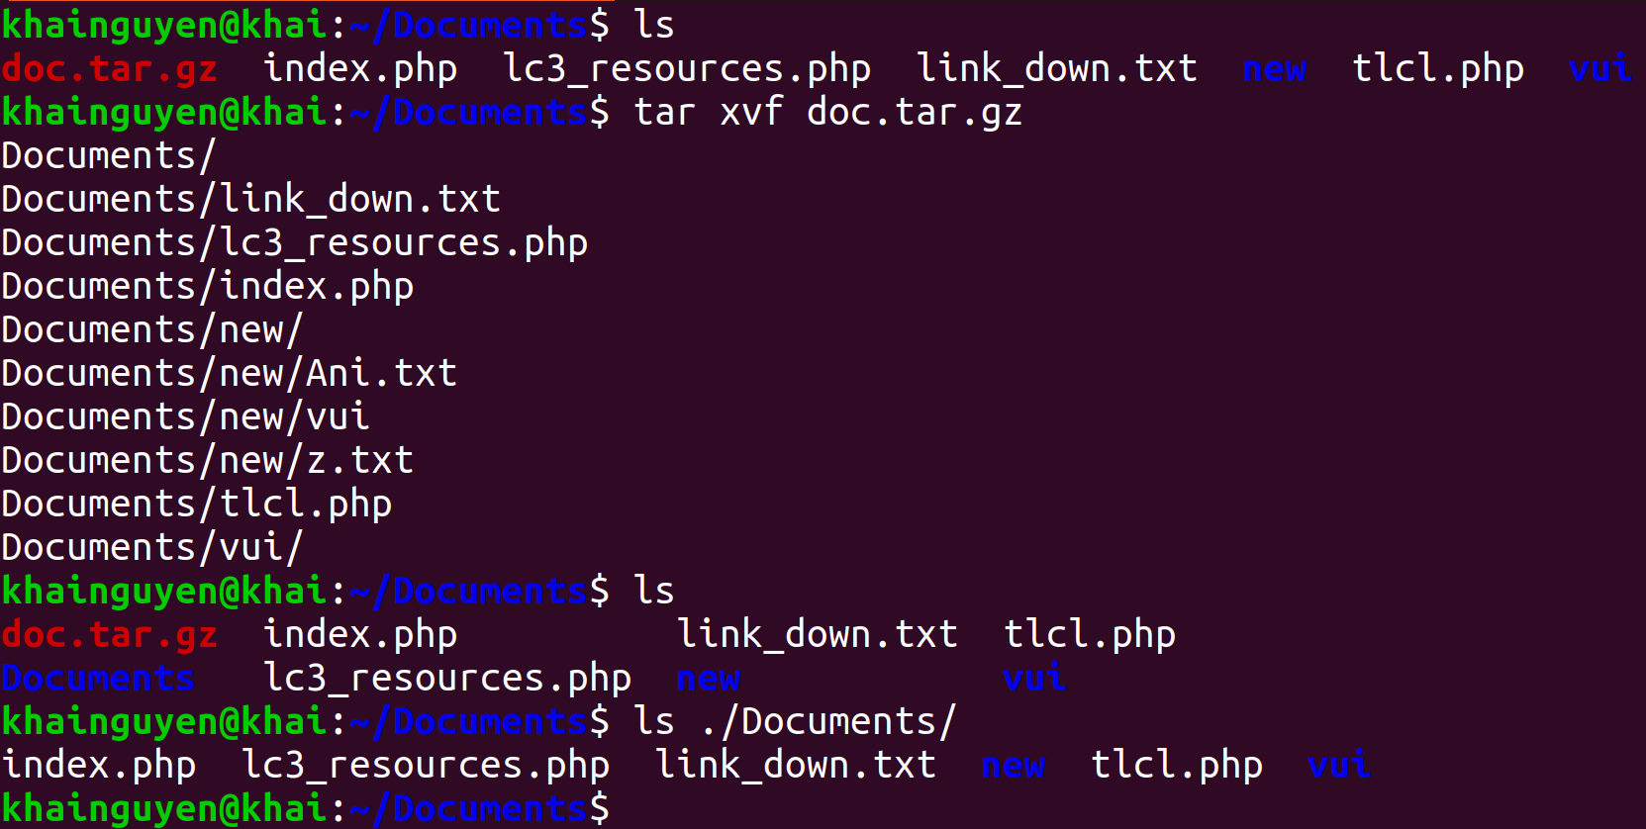
Compress and decompress
Decompress a compressed file named “doc.tar.gz"
-x, --extract: Extract files from an archive.

Slide 25
Summary
find | search for files or directories in a directory
head | prints the first few lines in the file
tail | prints the last few lines in the file
wc | print newline, word, and byte counts for each given file
cut | Print selected parts of lines from each FILE
grep | print lines that match patterns

Slide 26
Summary
| | pipe
“>”, “>>” | output redirection
“<” | input redirection
wget | download file from <link>
chmod | Change File Mode
tar | compress and decompress

Slide 27
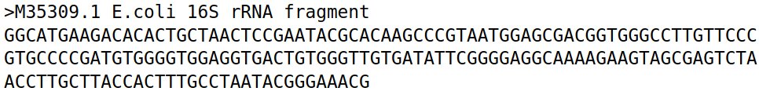
Homeworks
1. Create a directory named “hw2".
2. Move to “hw2" directory, and download this file (SRR25653406.fasta.tar.gz) using wget command:
https://github.com/UeenHuynh/MGMA_2024/raw/main/lecture2/2.%20basic%20Linux%20commands%20part%202/SRR25653406.fasta.tar.gz
3. Decompressing this file SRR25653406.fasta.tar.gz using tar command.
Additional information about FASTA format (The file has the extension .fasta, .faa, .fna, etc.):
FASTA format is a text-based format, contains two lines:
- First line: is the comment (description) line.
+ Always starts with “>” sign (This information is useful for the exercise).
+ Give basic information about the sequence (nucleotide or amino acid).
- Second line: The actual sequence of the first line description, using a standard one-letter character string.
Example:
(https://www.ncbi.nlm.nih.gov/nuccore/M35309.1?report=fasta)
=> Let's call this single-sequence FASTA format (https://en.wikipedia.org/wiki/FASTA_format), so if a text file contains a single-sequence FASTA format, this file is called a single-sequence FASTA file.
If a text file contains two or more single-sequence FASTA format, this file is called a multiple-sequence FASTA file or multi-FASTA file.

Slide 28
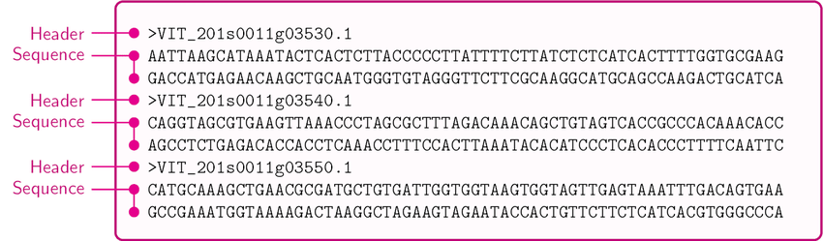
Homeworks
An example of multi-FASTA format :
(https://www.researchgate.net/figure/A-sample-of-the-Multi-FASTA-file_fig1_309134977)
Additional information for this file: SRR25653406.fasta (after decompressing using tar command).
- This is a multi-FASTA file. It is converted from fastq to fasta format file (Don't worry about fastq format in this exercise), the original fastq format file is obtained from the sequencing machine.
- Each single-sequence FASTA in this file is information about a read - a piece of DNA sequence obtained from the sequencing machine:
+ First line: some information about the sequencing platform of this file, that's all, don't worry about the details.
+ Second line: DNA sequence of that read, a character string consisting of 4 types of letters: A, T, G, C representing 4 types of nucleotides. In addition, there is the letter N, which means 1 of 4 possible types of nucleotides, because the sequencing machine cannot identify which type of nucleotide it is.

Slide 29
Homeworks
A single-sequence FASTA in this file:
(The DNA sequence has 2 lines because the screen is not enough to display 1 line, so it is split into 2 lines)
4. How many lines does this file have? Using: wc.
5. How many reads does this file have? Using: grep for the search “^>” means the line starts with the character ">", and -c option.
6. How many reads do not have any N? Using: grep with -v, -c option; pipe.
7. Create a file named "id_read.txt" containing only the first line (the line contains information) of all reads. Using: grep with “^v"; output redirection.

Slide 30
Homeworks
8. Create a file named "part_of_id_read.txt" containing a part of the first line (the line contains information) of all reads. Using: grep; pipe; cut; output redirection.
Two lines of 1 read:
(The line containing the DNA sequence has 2 lines because the screen is not enough to display 1 line, so it is split into 2 lines).
a part of the first line of 1 reads:

